Slide 1
Zoom
Scavenger
HUNT!!

Slide 2
How to Play:
Open the slide show BEFORE you share your screen so people can only see the first slide.
Show one item at a time and have Zoomers race to find it and bring it back.
If you want to keep score, go for it! Whoever returns and shows the item first wins a point.
If you don’t want to keep score, no worries.
It’s still a ton of fun!

Slide 3

Coffee Mug

Slide 4

Book

Slide 5

Piece of Fruit

Slide 6
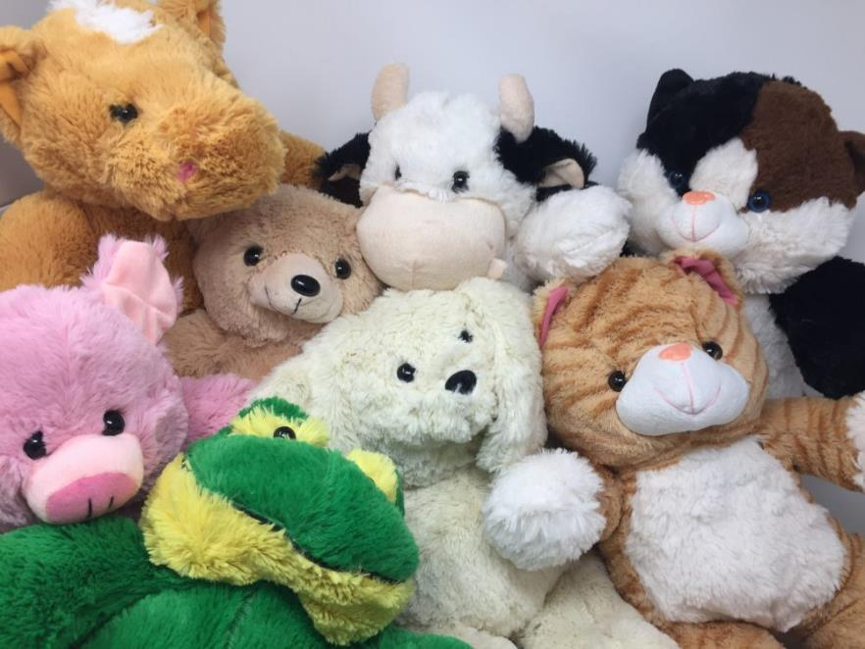
Stuffed Animal

Slide 7
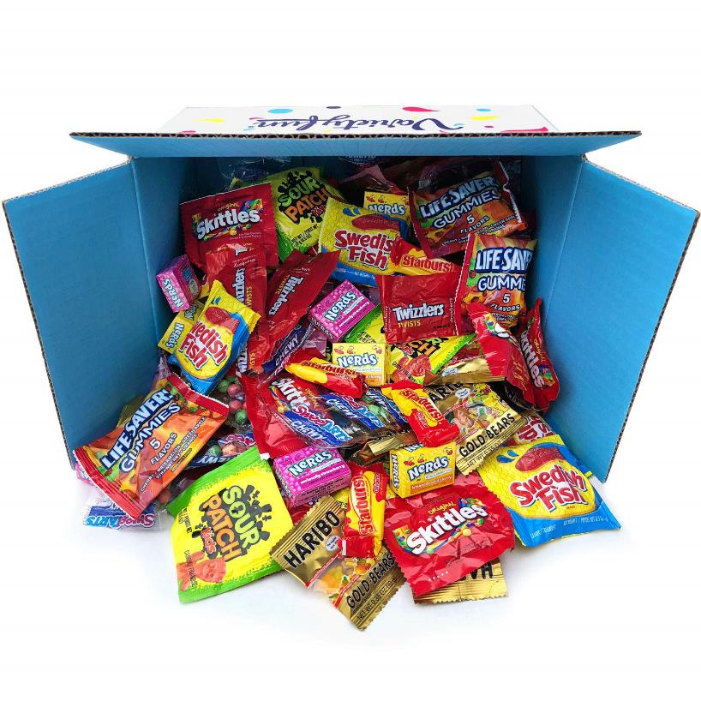
Candy

Slide 8

Notebook or Journal

Slide 9

Music CD

Slide 10
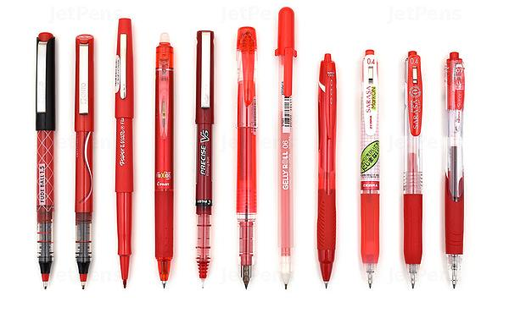
RED Pen

Slide 11
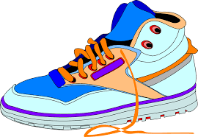
LEFT Sneaker

Slide 12

Can of Soda or Bottle of Water

Slide 13
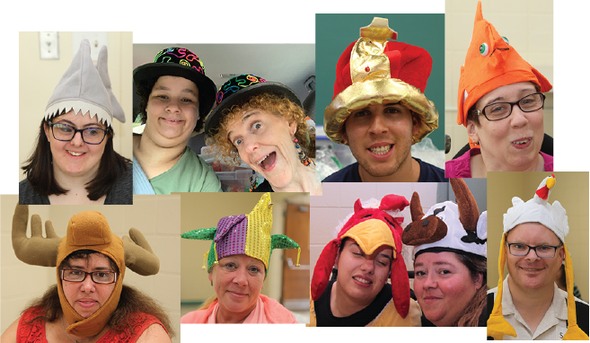

Hat
(Extra Points for a Silly One!)

Slide 14

Newspaper

Slide 15
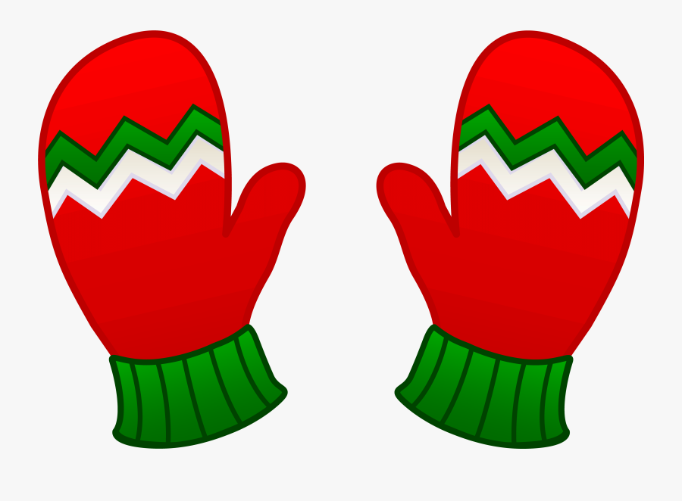
Pair of Mittens

Slide 16

Pillow

Slide 17
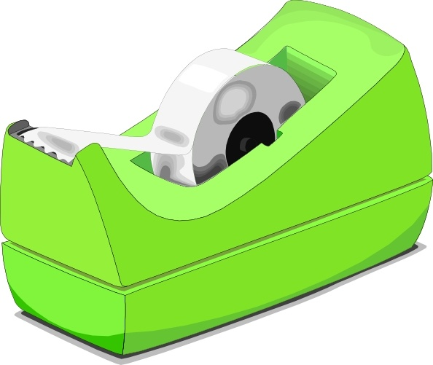
Roll of Tape

Slide 18
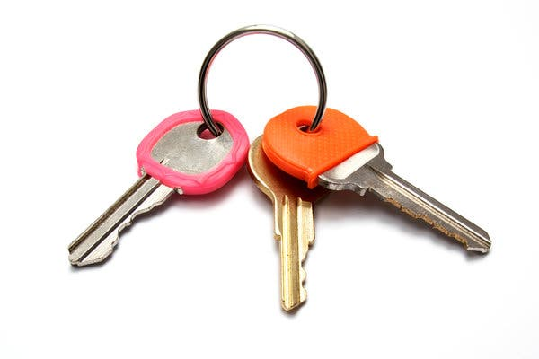
Keys

Slide 19
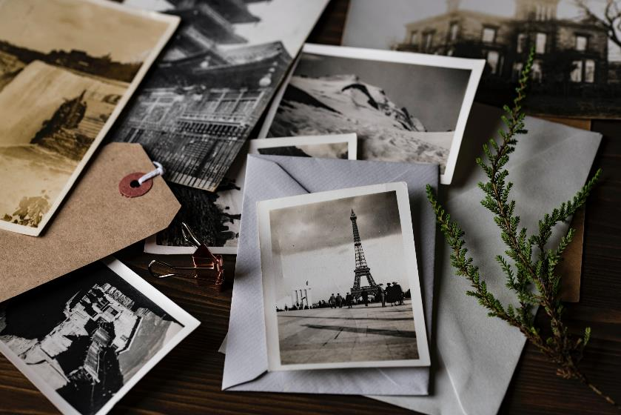
Printed Photograph

Slide 20
Money

Slide 21
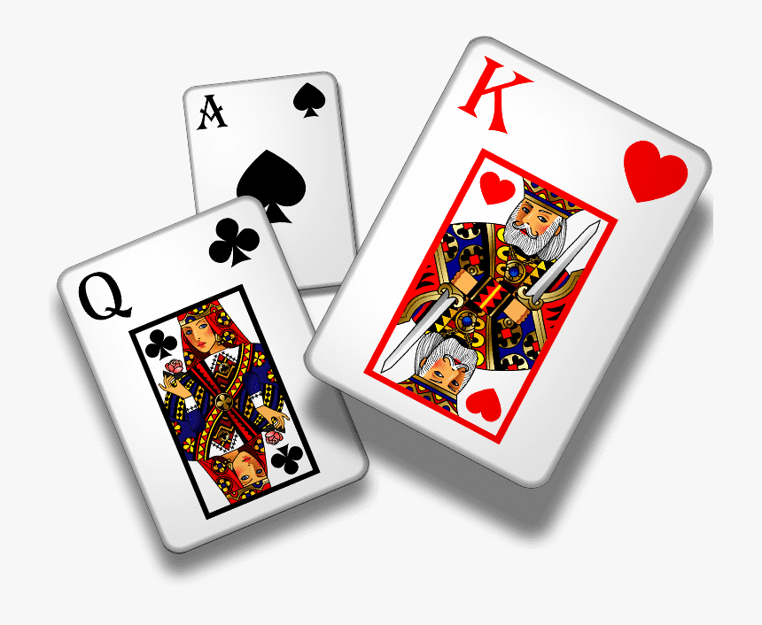
Deck of Cards

Slide 22
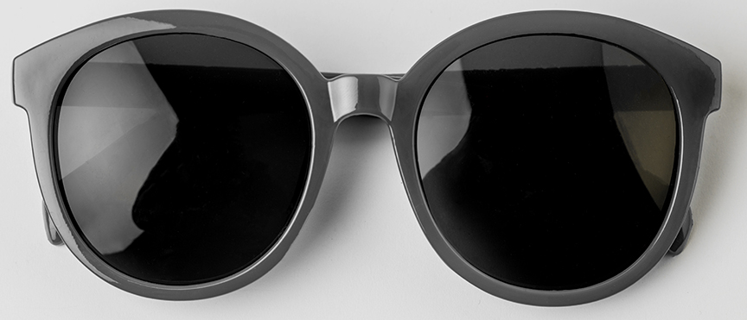
Sunglasses

Slide 23

Wooden Spoon

Slide 24
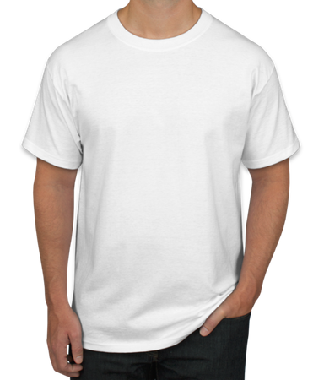

Something with the
Advocates in Action Logo

Slide 25
2 Tips for Adding More Scavenger Hunt Items …

Slide 26
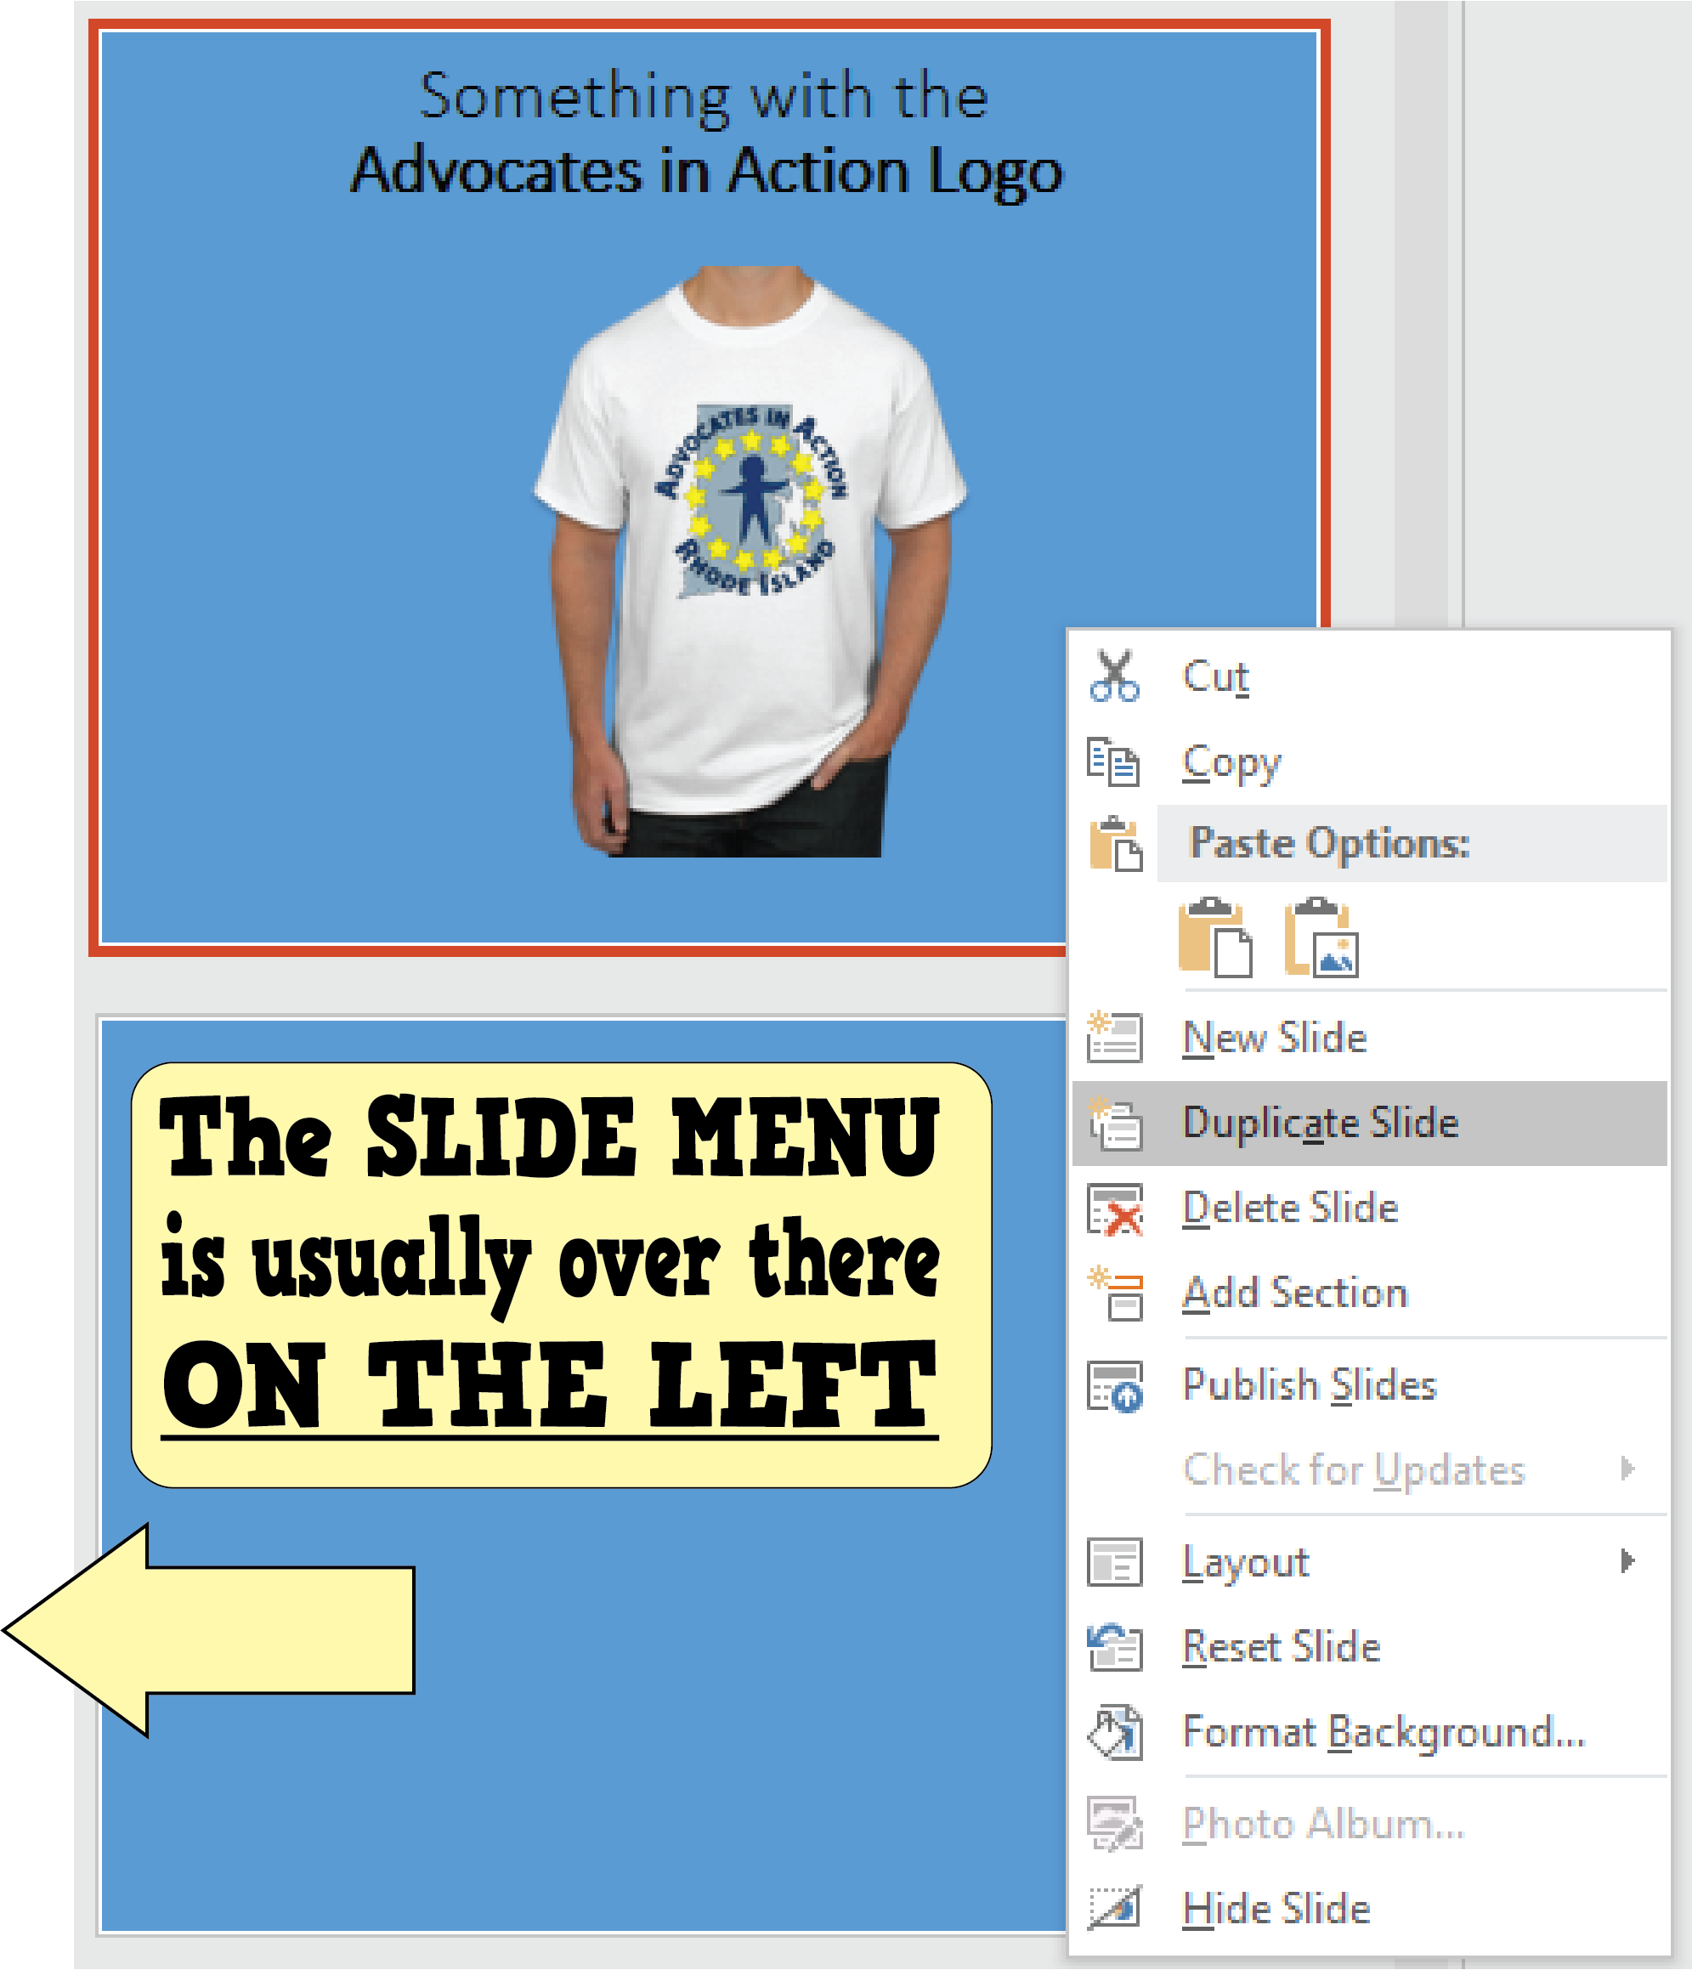
Tip #1: Don’t Start from Scratch,
Just DUPLICATE a Slide!
Use the SLIDE MENU
to DUPLICATE a slide
instead of
making a new one.
It makes life easier,
plus it keeps the
formatting the same.

Slide 27
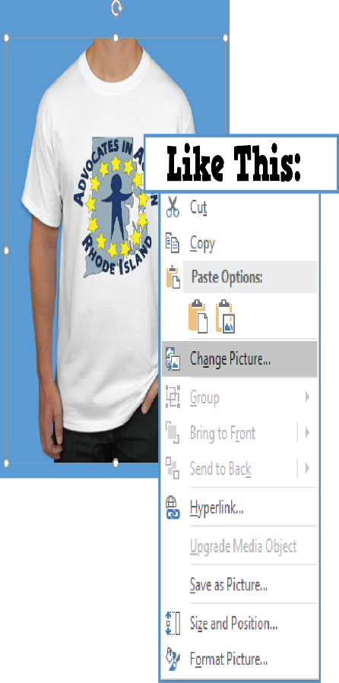

Tip #2: Change a Picture instead Inserting a New One
Doing this will help maintain
a consistent look between slides.
Plus, it’s easier and faster.
Less time to edit = more time to PLAY!
HAVE FUN!

Slide 28
© 2020 www.AdvocatesinAction.org
Visit us online for other activities and ideas.
We love sharing the fun!

